Slide 1

Distributed File Systems
From Coulouris, Dollimore, Kindberg and Blair
Distributed Systems:
Concepts and Design

Slide 2
Storage systems and their properties
Sharing
Persis-
Distributed
Consistency
Example
tence
cache/replicas
maintenance
Main memory
1
RAM
File system
1
UNIX file system
Distributed file system
Sun NFS
Web
Web server
Distributed shared memory
Ivy (DSM, Ch. 18)
Remote objects (RMI/ORB)
1
CORBA
Persistent object store
1
CORBA Persistent
Object Service
Peer-to-peer storage system
2
OceanStore (Ch. 10)
Types of consistency:
1: strict one-copy. 3: slightly weaker guarantees. 2: considerably weaker guarantees.
Instructor’s Guide for Coulouris, Dollimore, Kindberg and Blair, Distributed Systems: Concepts and Design Edn. 5
© Pearson Education 2012

Slide 3
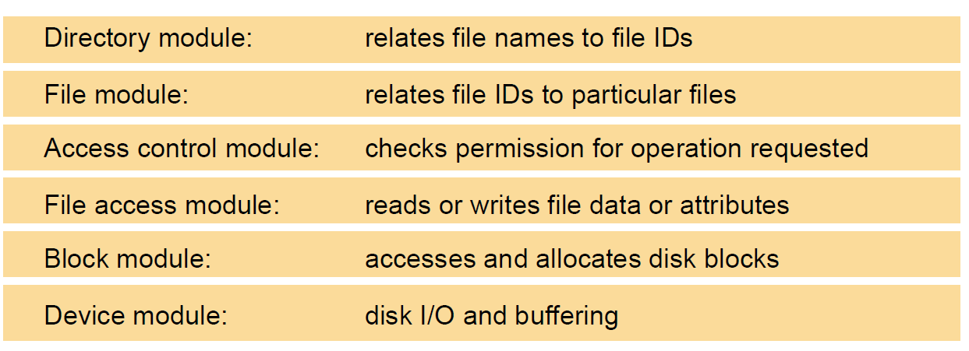
File system modules
Instructor’s Guide for Coulouris, Dollimore, Kindberg and Blair, Distributed Systems: Concepts and Design Edn. 5
© Pearson Education 2012

Slide 4
File attribute record structure
File length
Creation timestamp
Read timestamp
Write timestamp
Attribute timestamp
Reference count
Owner
File type
Access control list
Instructor’s Guide for Coulouris, Dollimore, Kindberg and Blair, Distributed Systems: Concepts and Design Edn. 5
© Pearson Education 2012

Slide 5
UNIX file system operations
filedes = open(name, mode)
Opens an existing file with the given name.
filedes = creat(name, mode)
Creates a new file with the given name.
Both operations deliver a file descriptor referencing the open
file. The mode is read, write or both.
status = close(filedes)
Closes the open file filedes.
count = read(filedes, buffer, n)
Transfers n bytes from the file referenced by filedes to buffer.
count = write(filedes, buffer, n)
Transfers n bytes to the file referenced by filedes from buffer.
Both operations deliver the number of bytes actually transferred
and advance the read-write pointer.
pos = lseek(filedes, offset,
Moves the read-write pointer to offset (relative or absolute,
whence)
depending on whence).
status = unlink(name)
Removes the file name from the directory structure. If the file
has no other names, it is deleted.
status = link(name1, name2)
Adds a new name (name2) for a file (name1).
status = stat(name, buffer)
Gets the file attributes for file name into buffer.
Instructor’s Guide for Coulouris, Dollimore, Kindberg and Blair, Distributed Systems: Concepts and Design Edn. 5
© Pearson Education 2012

Slide 6
File service architecture
Client computer
Server computer
Application
Application
Directory service
program
program
Flat file service
Client module
Instructor’s Guide for Coulouris, Dollimore, Kindberg and Blair, Distributed Systems: Concepts and Design Edn. 5
© Pearson Education 2012

Slide 7
Flat file service operations
Read(FileId, i, n) -> Data
If 1 ≤ i ≤ Length(File): Reads a sequence of up to n items
—
throws
BadPosition
from a file starting at item i and returns it in Data.
Write(FileId, i, Data)
If 1 ≤ i ≤ Length(File)+1: Writes a sequence of Data to a
—
throws
BadPosition
file, starting at item i, extending the file if necessary.
Create() -> FileId
Creates a new file of length 0 and delivers a UFID for it.
Delete(FileId)
Removes the file from the file store.
GetAttributes(FileId) -> Attr
Returns the file attributes for the file.
SetAttributes(FileId, Attr)
Sets the file attributes (only those attributes that are not
shaded in Figure 12.3).
Instructor’s Guide for Coulouris, Dollimore, Kindberg and Blair, Distributed Systems: Concepts and Design Edn. 5
© Pearson Education 2012

Slide 8
Directory service operations
Lookup(Dir, Name) -> FileId
Locates the text name in the directory and returns the
—
throws
NotFound
relevant UFID. If Name is not in the directory, throws an
exception.
AddName(Dir, Name, FileId)
If Name is not in the directory, adds (Name, File) to the
—
throws
NameDuplicate
directory and updates the file’s attribute record.
If Name is already in the directory: throws an exception.
UnName(Dir, Name)
If Name is in the directory: the entry containing Name is
—
throws
NotFound
removed from the directory.
If Name is not in the directory: throws an exception.
GetNames(Dir, Pattern) -> NameSeq
Returns all the text names in the directory that match the
regular expression Pattern.
Instructor’s Guide for Coulouris, Dollimore, Kindberg and Blair, Distributed Systems: Concepts and Design Edn. 5
© Pearson Education 2012

Slide 9
NFS architecture
Client computer
Server computer
Application
Application
program
program
UNIX
system calls
UNIX kernel
UNIX kernel
Virtual file system
Virtual file system
Local
Remote
UNIX
Other
file system
NFS
NFS
UNIX
file
client
server
file
system
NFS
system
protocol
Instructor’s Guide for Coulouris, Dollimore, Kindberg and Blair, Distributed Systems: Concepts and Design Edn. 5
© Pearson Education 2012

Slide 10
NFS server operations (simplified) – 1
lookup(dirfh, name) -> fh, attr
Returns file handle and attributes for the file name in the directory
dirfh.
create(dirfh, name, attr) ->
Creates a new file name in directory dirfh with attributes attr and
newfh, attr
returns the new file handle and attributes.
remove(dirfh, name) status
Removes file name from directory dirfh.
getattr(fh) -> attr
Returns file attributes of file fh. (Similar to the UNIX stat system
call.)
setattr(fh, attr) -> attr
Sets the attributes (mode, user id, group id, size, access time and
modify time of a file). Setting the size to 0 truncates the file.
read(fh, offset, count) -> attr, data
Returns up to count bytes of data from a file starting at offset.
Also returns the latest attributes of the file.
write(fh, offset, count, data) -> attr
Writes count bytes of data to a file starting at offset. Returns the
attributes of the file after the write has taken place.
rename(dirfh, name, todirfh, toname)
Changes the name of file name in directory dirfh to toname in
-> status
directory to todirfh
.
link(newdirfh, newname, dirfh, name)
Creates an entry newname in the directory newdirfh which refers to
-> status
file name in the directory dirfh.
Continues on next slide ...
Instructor’s Guide for Coulouris, Dollimore, Kindberg and Blair, Distributed Systems: Concepts and Design Edn. 5
© Pearson Education 2012

Slide 11
NFS server operations (simplified) – 2
symlink(newdirfh, newname, string)
Creates an entry newname in the directory newdirfh of type
-> status
symbolic link with the value string. The server does not interpret
the string but makes a symbolic link file to hold it.
readlink(fh) -> string
Returns the string that is associated with the symbolic link file
identified by fh.
mkdir(dirfh, name, attr) ->
newfh, attr
Creates a new directory name with attributes attr and returns the
new file handle and attributes.
rmdir(dirfh, name) -> status
Removes the empty directory name from the parent directory dirfh.
Fails if the directory is not empty.
readdir(dirfh, cookie, count) ->
entries
Returns up to count bytes of directory entries from the directory
dirfh. Each entry contains a file name, a file handle, and an opaque
pointer to the next directory entry, called a cookie. The cookie is
used in subsequent readdir calls to start reading from the following
entry. If the value of cookie is 0, reads from the first entry in the
directory.
statfs(fh) -> fsstats
Returns file system information (such as block size, number of
free blocks and so on) for the file system containing a file fh.
Instructor’s Guide for Coulouris, Dollimore, Kindberg and Blair, Distributed Systems: Concepts and Design Edn. 5
© Pearson Education 2012

Slide 12
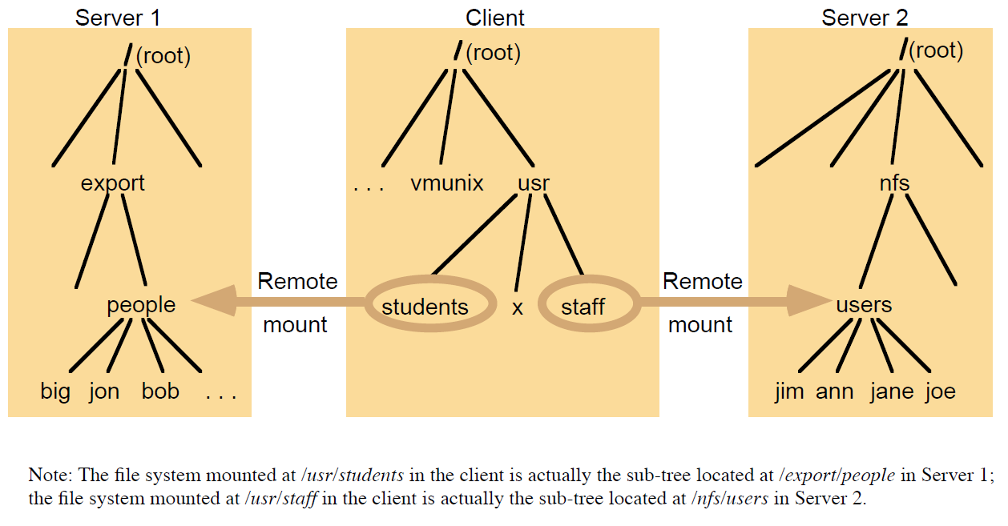
Local and remote file systems accessible on an NFS client
Note:
The file system mounted at /usr/students in the client is actually the sub-tree located at /export/people in Server 1;
the file system mounted at /usr/staff in the client is actually the sub-tree located at /nfs/users in Server 2.
Instructor’s Guide for Coulouris, Dollimore, Kindberg and Blair, Distributed Systems: Concepts and Design Edn. 5
© Pearson Education 2012

Slide 13
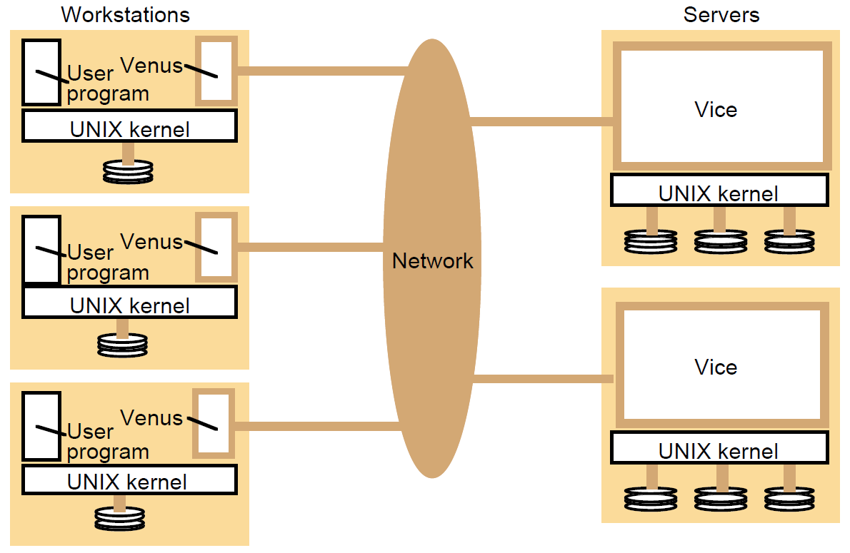
Distribution of processes in the Andrew File System
Instructor’s Guide for Coulouris, Dollimore, Kindberg and Blair, Distributed Systems: Concepts and Design Edn. 5
© Pearson Education 2012

Slide 14
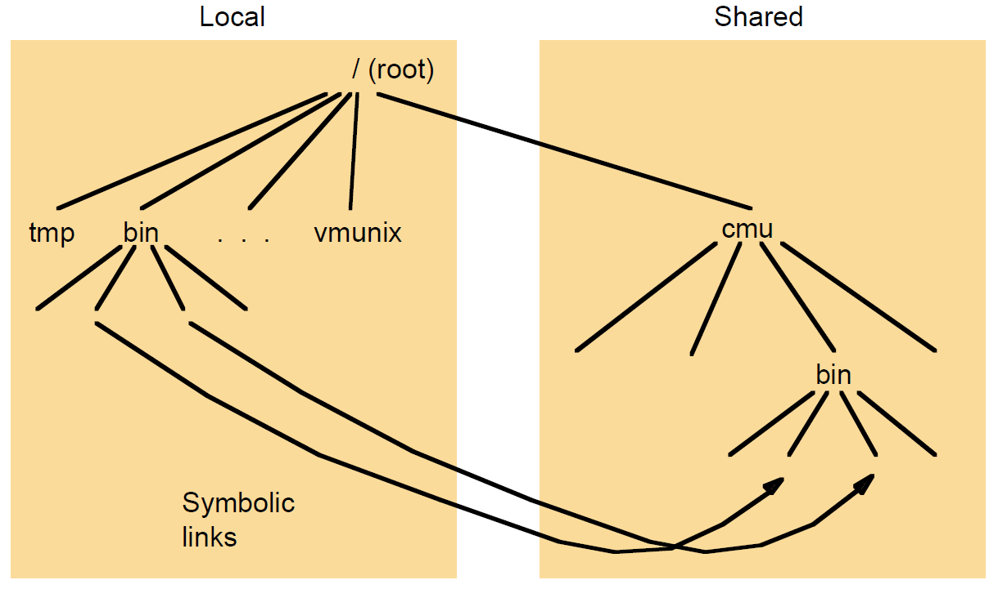
File name space seen by clients of AFS
Instructor’s Guide for Coulouris, Dollimore, Kindberg and Blair, Distributed Systems: Concepts and Design Edn. 5
© Pearson Education 2012

Slide 15
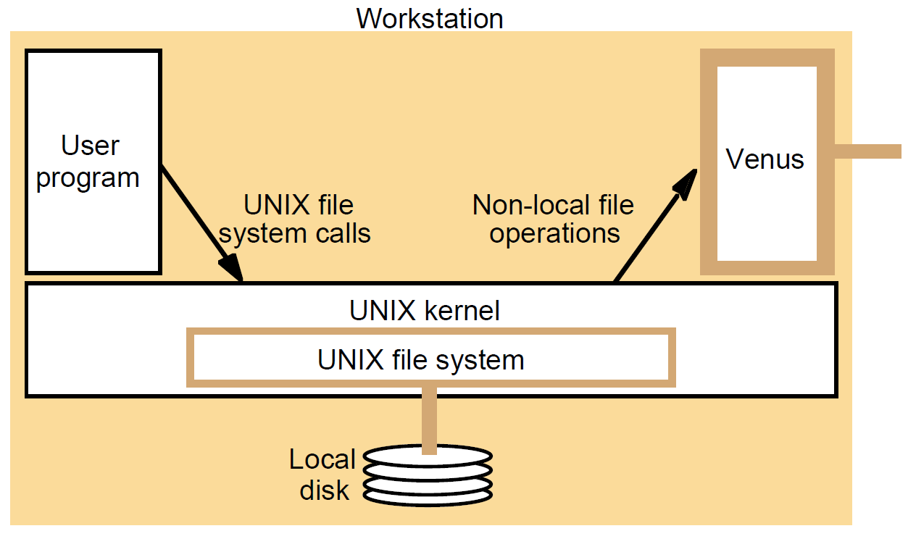
System call interception in AFS
Instructor’s Guide for Coulouris, Dollimore, Kindberg and Blair, Distributed Systems: Concepts and Design Edn. 5
© Pearson Education 2012

Slide 16
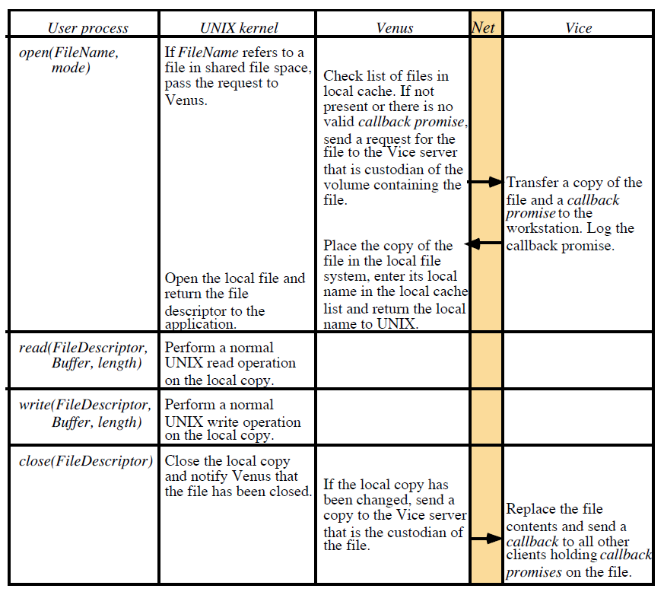
Implementation of file system calls in AFS
Instructor’s Guide for Coulouris, Dollimore, Kindberg and Blair, Distributed Systems: Concepts and Design Edn. 5
© Pearson Education 2012

Slide 17
The main components of the Vice service interface
Fetch(fid) -> attr, data
Returns the attributes (status) and, optionally, the contents of file
identified by the fid and records a callback promise on it.
Store(fid, attr, data)
Updates the attributes and (optionally) the contents of a specified
file.
Create() -> fid
Creates a new file and records a callback promise on it.
Remove(fid)
Deletes the specified file.
SetLock(fid, mode)
Sets a lock on the specified file or directory. The mode of the
lock may be shared or exclusive. Locks that are not removed
expire after 30 minutes.
ReleaseLock(fid)
Unlocks the specified file or directory.
RemoveCallback(fid)
Informs server that a Venus process has flushed a file from its
cache.
BreakCallback(fid)
This call is made by a Vice server to a Venus process. It cancels
the callback promise on the relevant file.
Instructor’s Guide for Coulouris, Dollimore, Kindberg and Blair, Distributed Systems: Concepts and Design Edn. 5
© Pearson Education 2012

